Slide 1
Methods to deal with collinearity Ridge Regression LASSO Regression

Slide 2
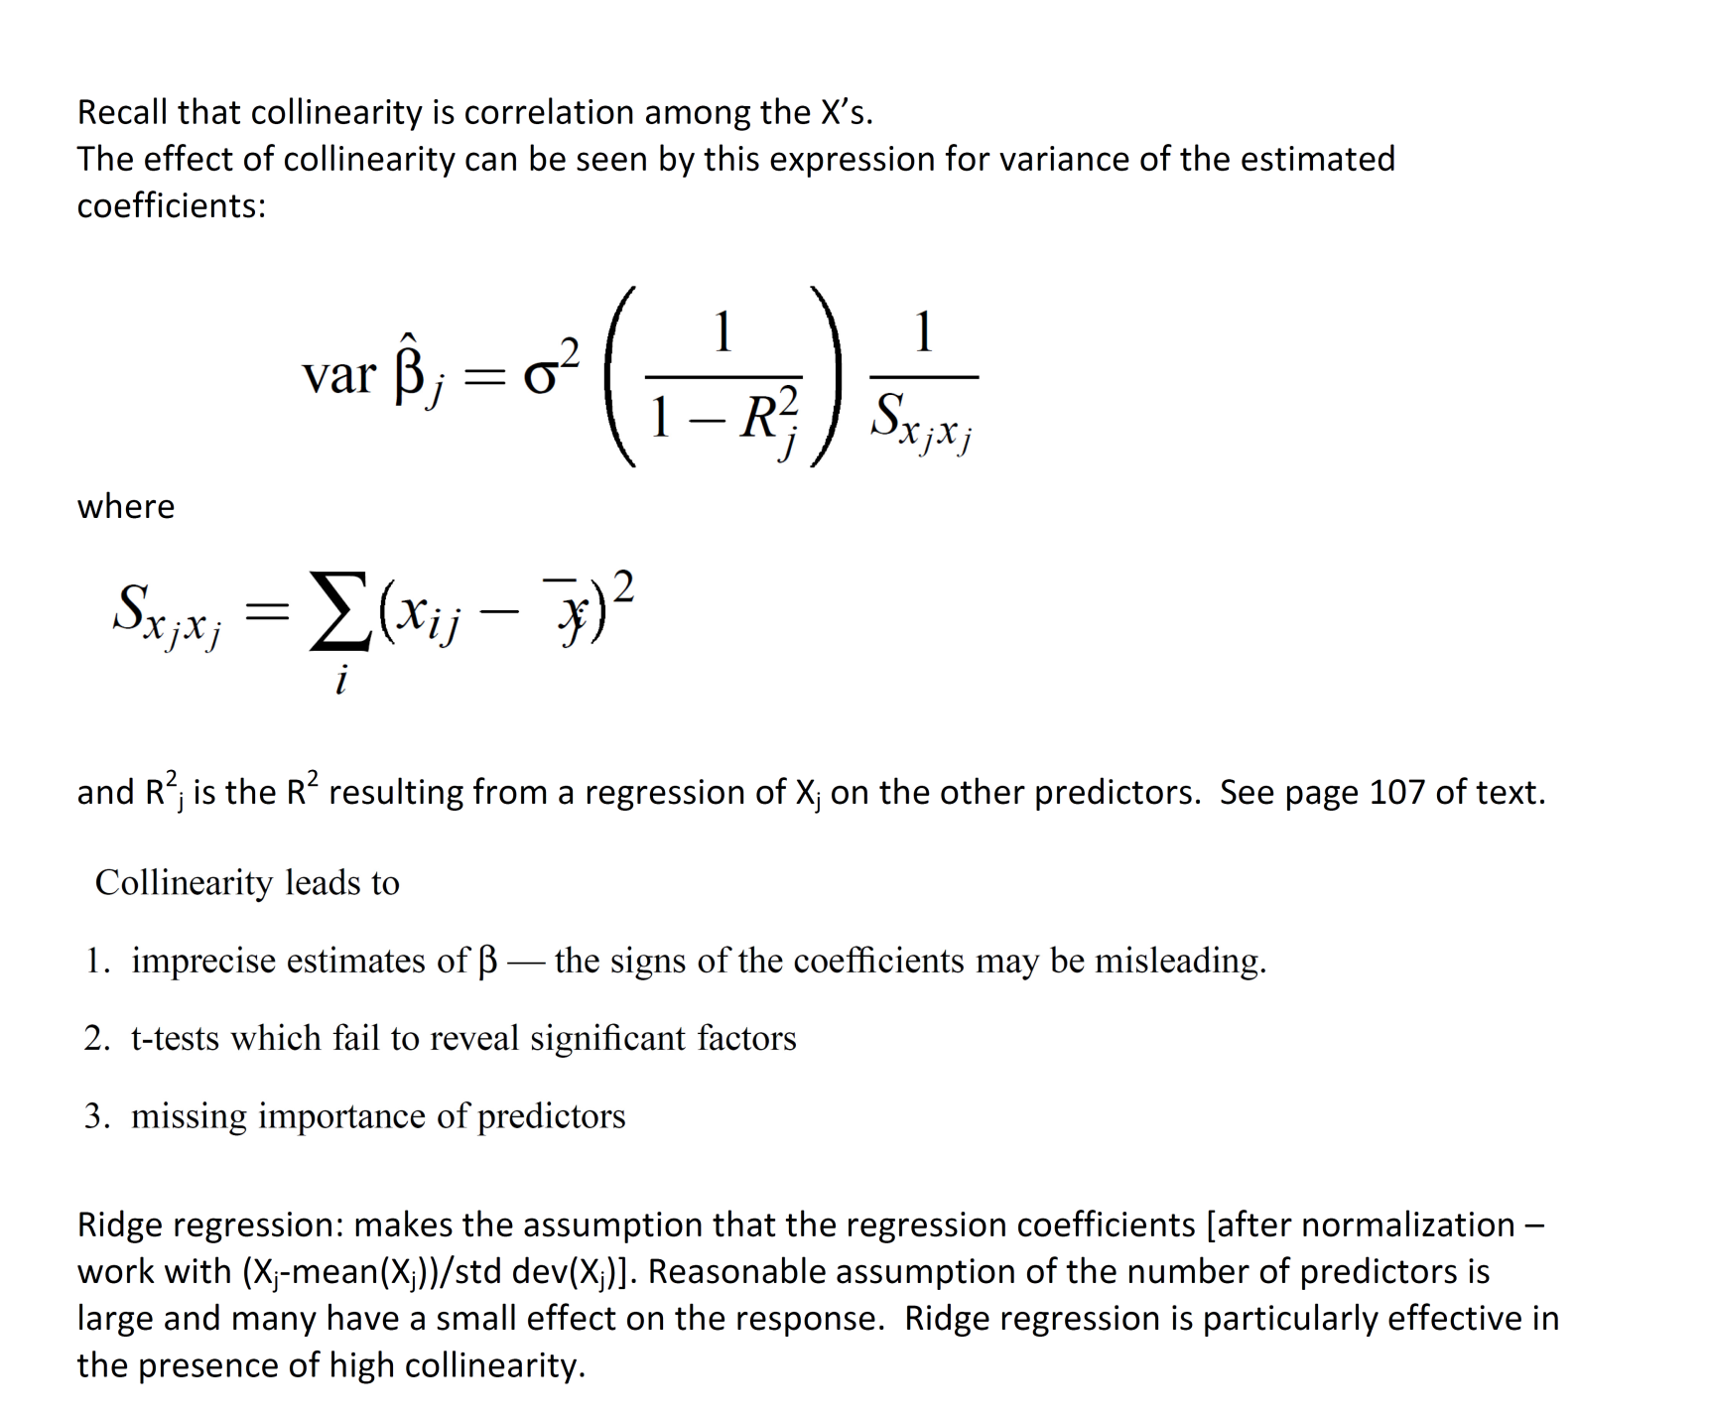
See collin_seatpos.R for an example of a dataset with high collinearity
should not be very large
if

Slide 3
Methods for Dealing with Multicollinearity
Least squares estimation gives an unbiased estimate,
with minimum variance – but this variance may still be very large, resulting in unstable estimates of the coefficients.
Alternative: Find an estimate that is biased but with smaller variance than the unbiased estimator

Slide 4
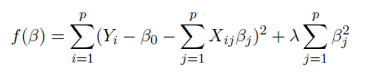
Methods for Dealing with Multicollinearity
Ridge Estimator
k is a “biasing parameter” usually between 0 and 1.
k defines ridges
k
Find estimators that minimize

Slide 5
Methods for Dealing with Multicollinearity
The effect of k on the MSE
Recall:
Now,
As k ↑, Var ↓, and bias ↑
Choose k such that the reduction in variance > increase in bias.
See next page for Existence Theorem
lambda_{j}’s are eigenvalues of X’X

Slide 6
Notation: lambda above is k in our notation

Slide 7
Methods for Dealing with Multicollinearity
Ridge Trace
Plots k against the coefficient estimates. If multicollinearity is severe, the ridge trace will show it. Choose k such that is stable and hope the MSE is acceptable
Ridge regression is a good alternative if the model user wants to have all regressors in the model.

Slide 8
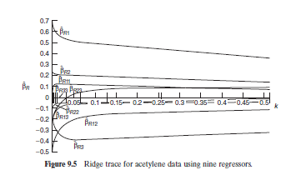
Methods for Dealing with Multicollinearity

Slide 9
LASSO (Least Absolute Shrinkage and Selection Operator) Regression

Slide 10
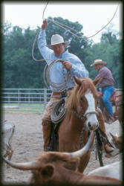
Introduction
The Lasso is a shrinkage and selection method for linear regression. It minimizes the usual sum of squared errors, with a bound on the sum of the absolute values of the coefficients.
Tibshirani, R. (1996), “Regression Shrinkage and Selection via the Lasso,” Journal of the Royal Statistical Society, Series B, 58, 267–288.
According to Faraway (Linear Models with R): “The name, Lasso, is not an acronym. It refers to the rope used by cowboys to pull cattle from the herd just as the statistician selects variables from the full model.”
Picture from: http://statweb.stanford.edu/~tibs/lasso.html

Slide 11
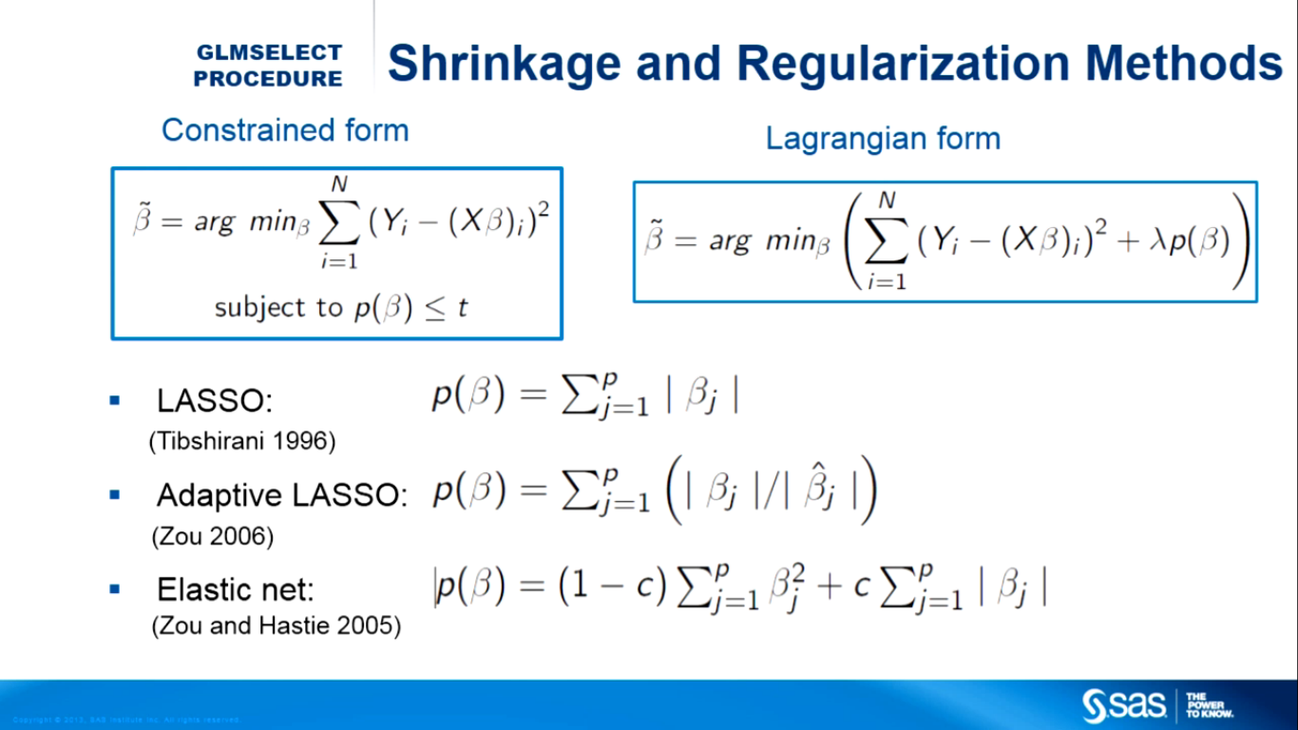
Overview
bridges LASSO (c=1) and Ridge (c=0)
Y

Slide 12

Ridge versus Lasso Regression
Ridge Regression finds estimators that minimize
Least absolute shrinkage and selection operator (1996)
LASSO: no closed form expression - require numerical techniques. Procedure will set some of the Betas equal to zero. In this way, Lasso itself decides which variables are unnecessary and removes them from the model.

Slide 13
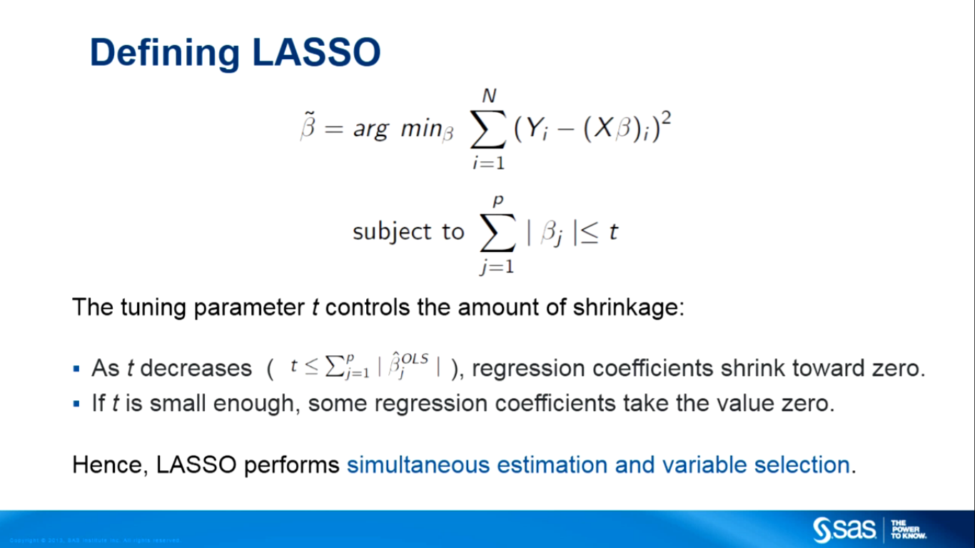
Defining LASSO (1)

Slide 14
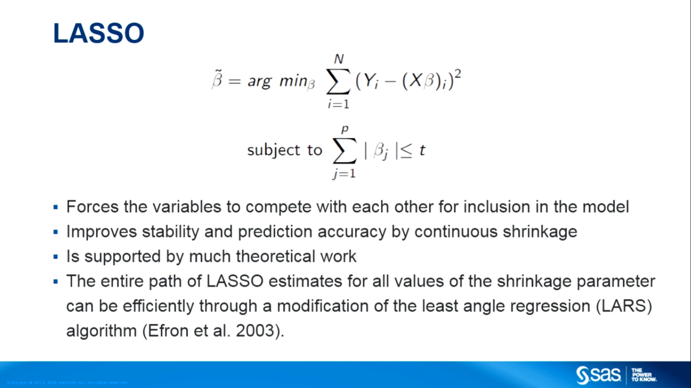
Defining LASSO (2)
obtained
^
LASSO is a convex optimization technique – hence you can obtain the whole solution path on a desktop machine within seconds.

Slide 15
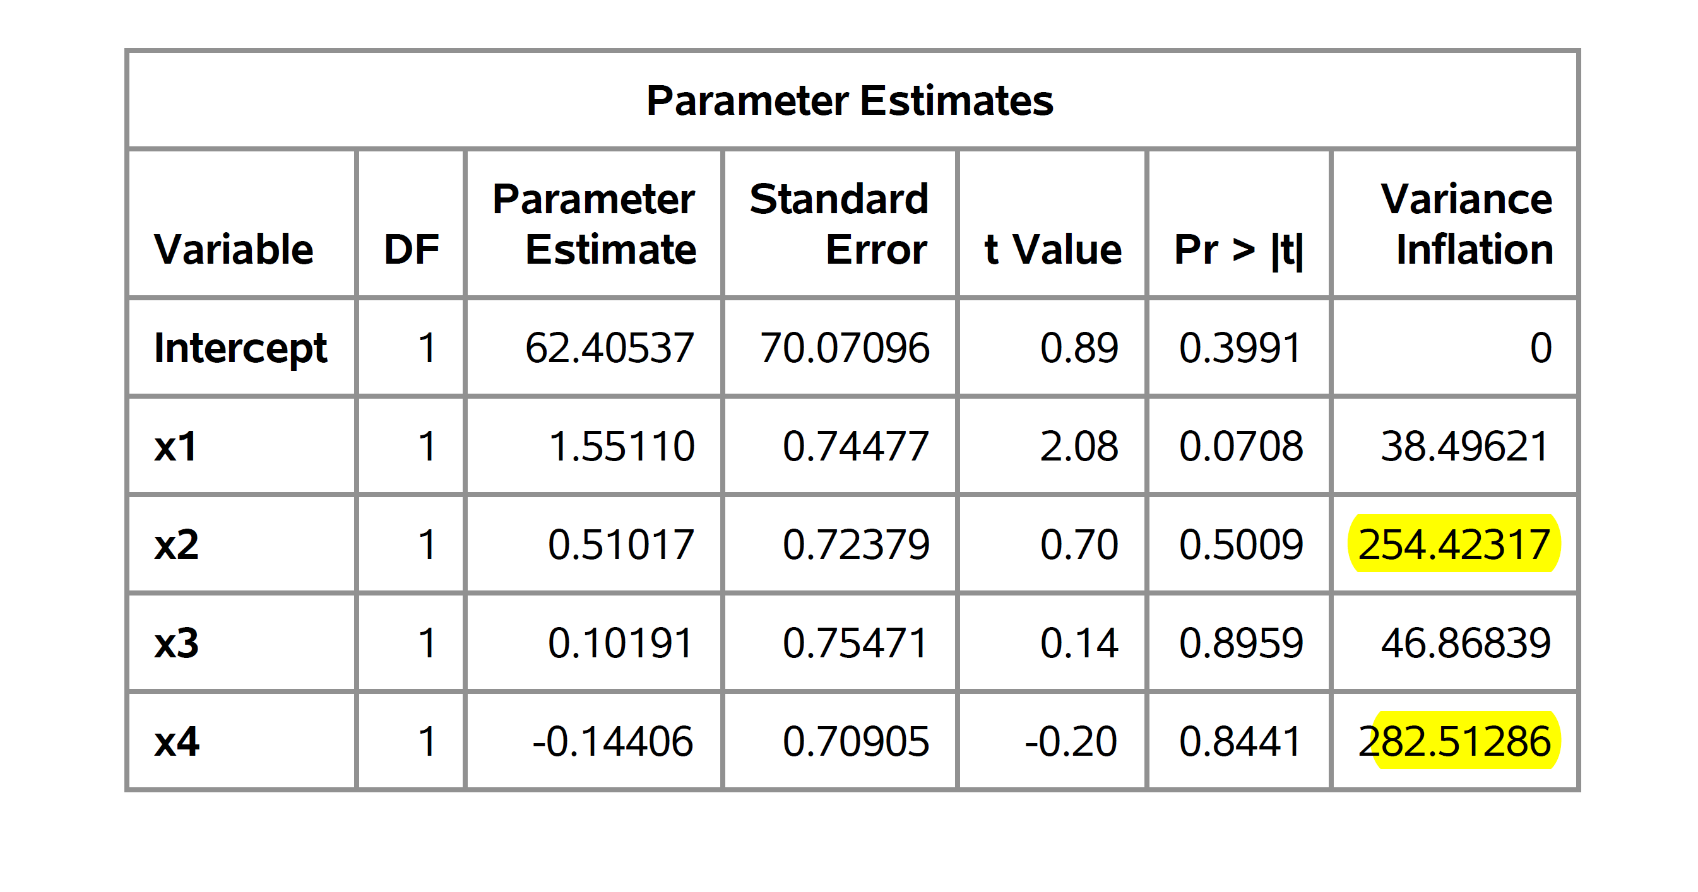
Example: Ridge and LASSO in the presence of high multicollinearity
The underlying data set has 13 rows and 5 columns with high multicollinearity
VIF=1/(1-R_{p}²)
See ridgevslasso.sas, ridgevslasso.pdf

Slide 16
Ridge estimates across various values of lambda
From Proc Reg in SAS

Slide 17
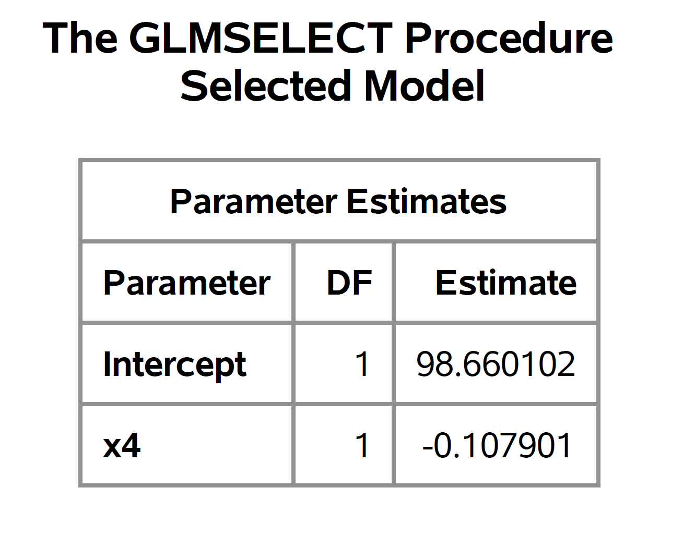
LASSO selection and estimation

Slide 18
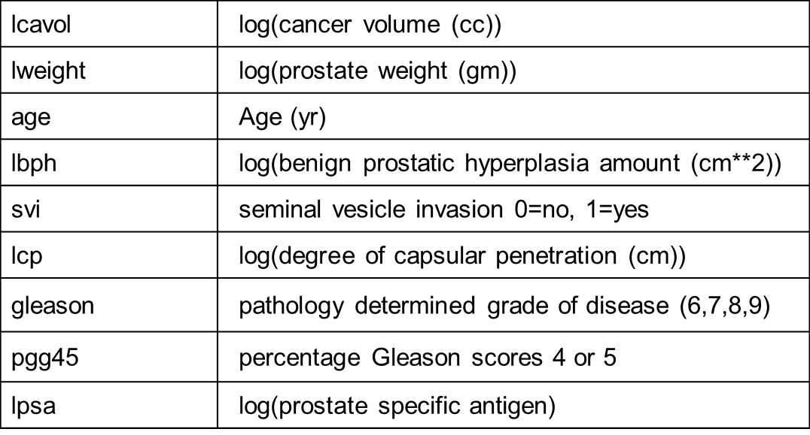
Example: Prostate Cancer Data Set
The data set has 97 rows and 9 columns. It is from a study of 97 men with prostate cancer who were due to receive a radical prostatectomy. The columns in the data frame are associated with the following variables.
Here Y = lpsa is continuous

Slide 19
Prostate data does not show high multicollinearity

Slide 20
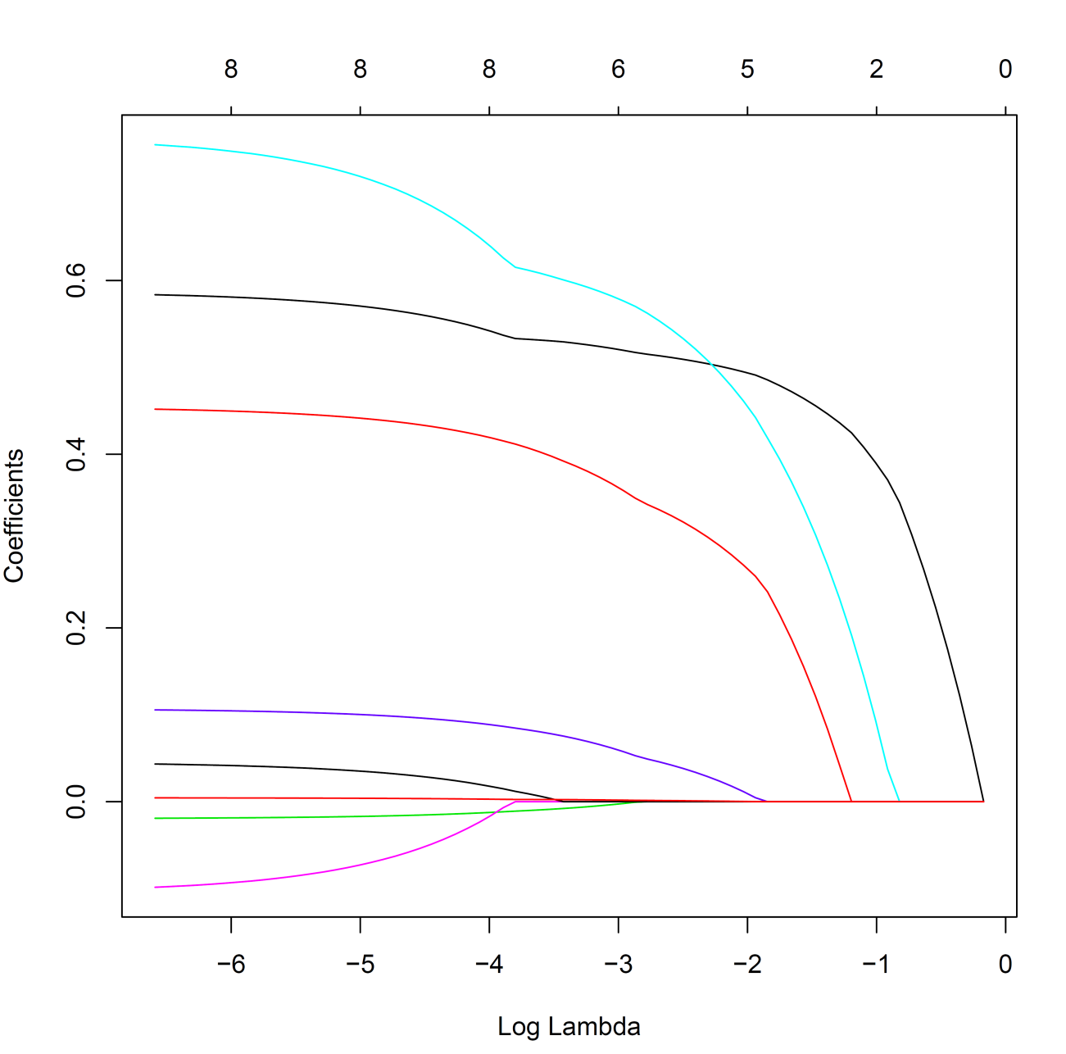

GLMNET in R performs LASSO
Coefficients start to decrease and finally all drop to 0 as the penalty becomes more important (lambda goes to 1).
How to choose lambda? 2 suggestions
Measure of model fit (AIC, AICc, SBC, BIC, etc.)
Cross validation: Specify a finite set of lambdas. For each lambda, sample is split into K (5, 10, 20, etc.) folds – model is fit K times each time omit one of the folds and each time compute
SSE (lambda)=sum((observed-predicted)²)
CV(lambda) = mean(SSE(lambda))
Choose lambda where CV(lambda) is a minimum.
Results from LASSO fit in R
with all 8 predictors

Slide 21
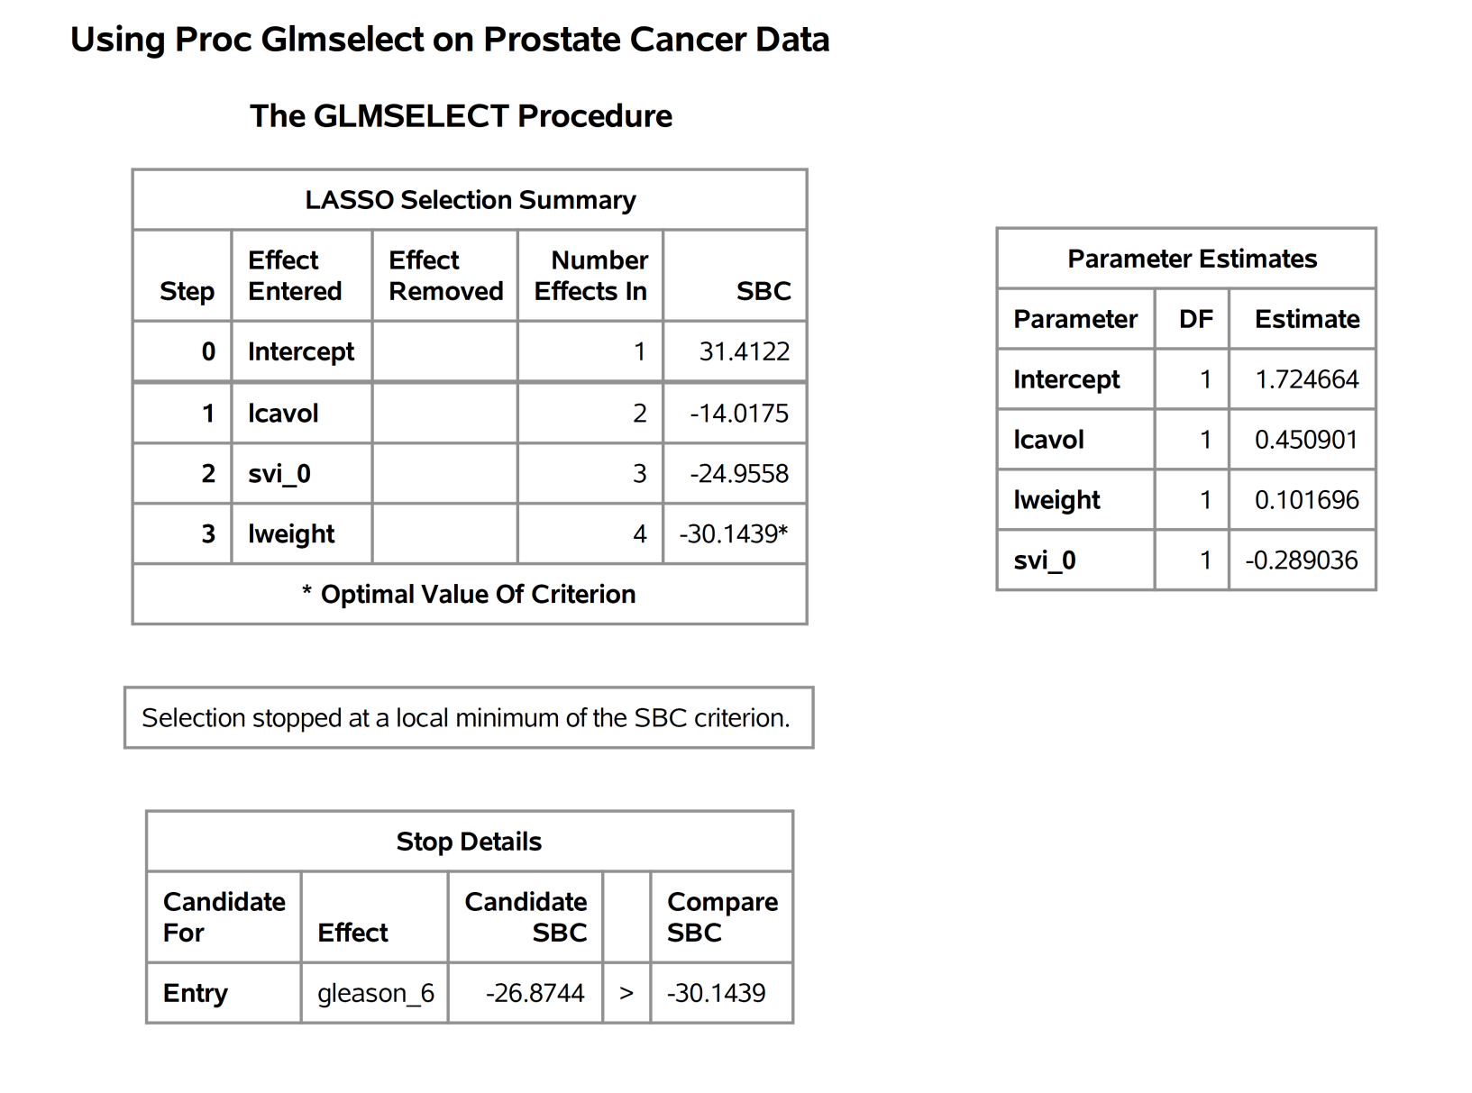
PROC GLMSELECT performs LASSO
proc glmselect data=prostate plots(stepaxis=normb)=COEFFICIENTS;
class svi gleason;
model lpsa=lcavol lweight age lbph svi lcp gleason pgg45/selection=lasso;
run;

Slide 22
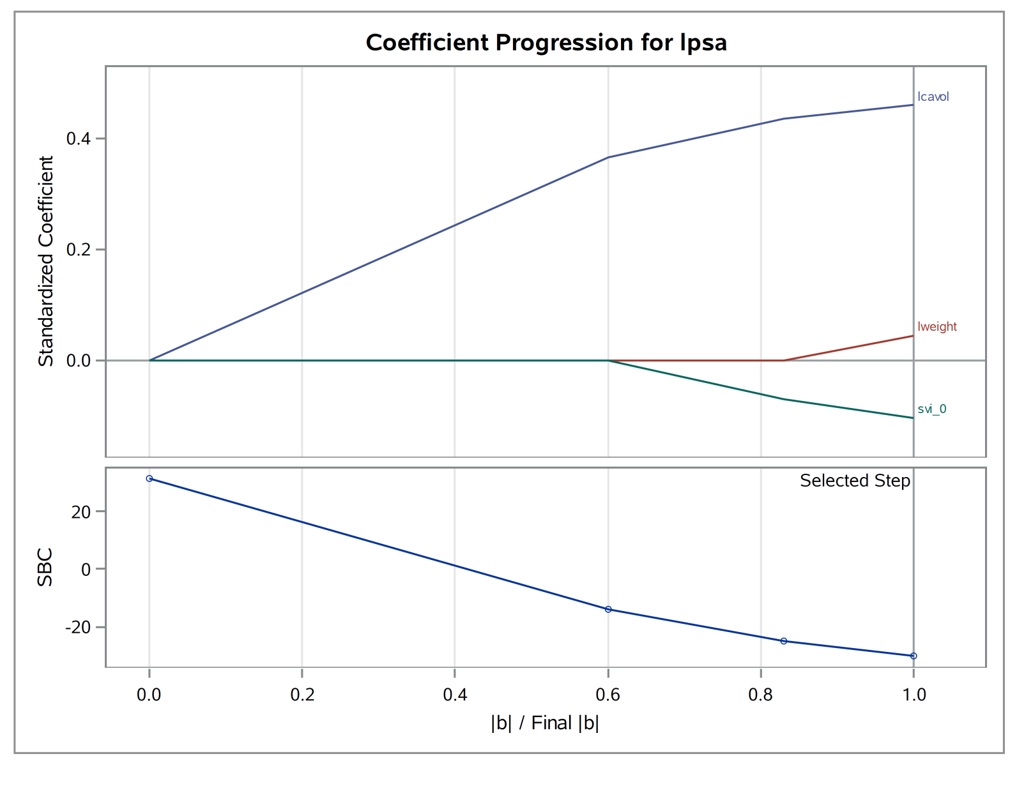
PROC GLMSELECT performs LASSO

Slide 23
GLMNET in R performs LASSO
GLMNET handles a family of distributions: Gaussian, Multivariate Gaussian, Cox, Poisson, binomial, multinomial
Examples in R:
Prostate cancer data y = lpsa
Prostate cancer data y=svi (0,1) LASSO-regularized regression

